Slide 1

Digital Transformation
& Data Governance.
Through the lens of Africa.
Facilitator
Pendo Manjele

Slide 2
THE LONG VIEW
The Industrial Revolution…
Each revolution didn't replace the last one — it was built on top of it.
Industry 4.0
IoT & big data
Today
Industry 3.0
Automation
20th century
Industry 2.0
Mass production
18th century
Industry 1.0
Steam power
17th century
Africa entered 1.0–3.0 mostly as a resource supplier. The question for 4.0: repeat that pattern — or break it?
2 / 40

Slide 3
MENTIMETER · LIVE WORD CLOUD
When you hear ‘Artificial Intelligence,’
what comes to mind?
Add your first word to the cloud — one word, no overthinking.
3 / 40

Slide 4
FOUNDATIONS
Definitions.
The vocabulary we’ll be using all session.
Artificial Intelligence (AI)
The ability of a digital computer or computer-controlled robot to perform tasks commonly associated with intelligent beings.
Digital Transformation
The strategic integration of digital technologies and data infrastructure across entire nations to fundamentally modernise economies, governance and societies.
Data Governance
The shared principles, legal instruments and policies used to manage, protect and utilise data.
Digital Public Infrastructure (DPI)
The foundational digital systems and technologies that support the delivery of public and private services.
Data
The information — facts, numbers, words and signals — that helps us understand the world and turn everyday moments into insight.
4 / 40

Slide 5



FOCUS
Three threads for this session.
Critical minerals
Africa’s mineral wealth and its place in the AI hardware supply chain.
AI geopolitics
How the US–China contest for compute and minerals plays out on the continent.
The governance challenge
Avoiding extractive ‘infrastructure-for-data’ deals in Africa’s digital transformation.
5 / 40

Slide 6



GLOBAL CONTEXT
Benefits of AI.
The upside case the world is racing toward — the backdrop against which Africa’s question sits.
Increased Productivity
New Job Creation
Economic Growth
Time to strategic work
170M new jobs by 2030
$13T global economy
AI-powered automation and decision support can enhance worker productivity and free up time for higher-value, strategic tasks.
WEF projects 170 million new roles created globally by 2030, against 92 million displaced — a net gain of 78 million jobs.
Widespread AI adoption could add up to $13 trillion to global economic output by 2030 — a 16% rise in cumulative GDP.
WEF, Future of Jobs Report 2025
McKinsey Global Institute
6 / 40

Slide 7
II. THE PRESENT
Is Africa positioned to harness these benefits?
And if so — what share?
2.5%
0.3%
10%
of the global AI market
Africa currently captures
share of projected global
AI investment flowing to Africa
the share Africa would need to capture
just to unlock $1.5T by 2030
Africa holds 17% of the world’s population — and roughly 1–2% of global AI spending. The $1.5T upside is real, but it assumes a 4x jump from where the continent stands today.
Sources: UNESCO / AfDB–World Bank AI conference, Nov 2025; SAP Africa / ITWeb, Jun 2025; DigitalDefynd AI Statistics, 2025.
7 / 40

Slide 8
When you think of the world’s AI or
technology leaders, who comes to mind?
8 / 40

Slide 9
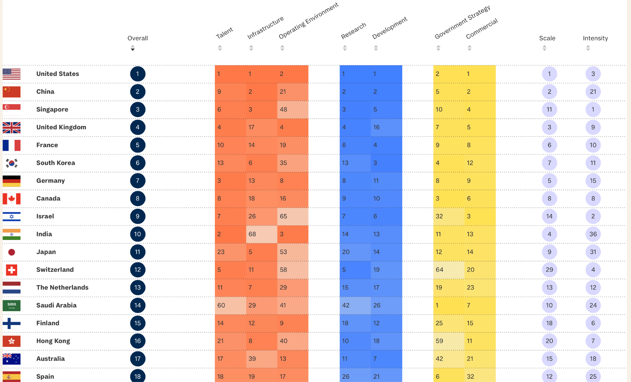
II. THE PRESENT
Where does Africa rank in the global AI race?
Egypt: 52nd
highest-ranked African nation
No Sub-Saharan nation
appears in the Top 50
9 / 40

Slide 10
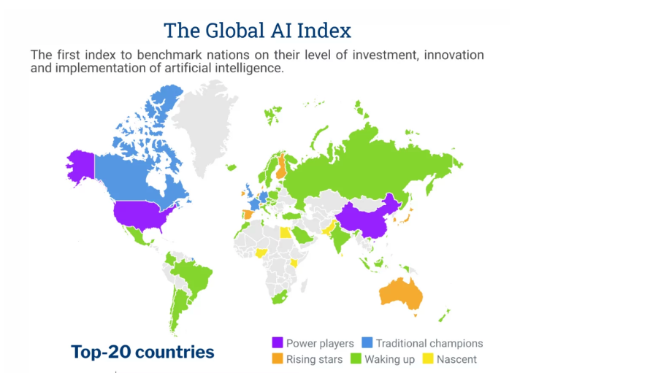
II. THE PRESENT
Where does Africa rank in the global AI race?
10 / 40

Slide 11
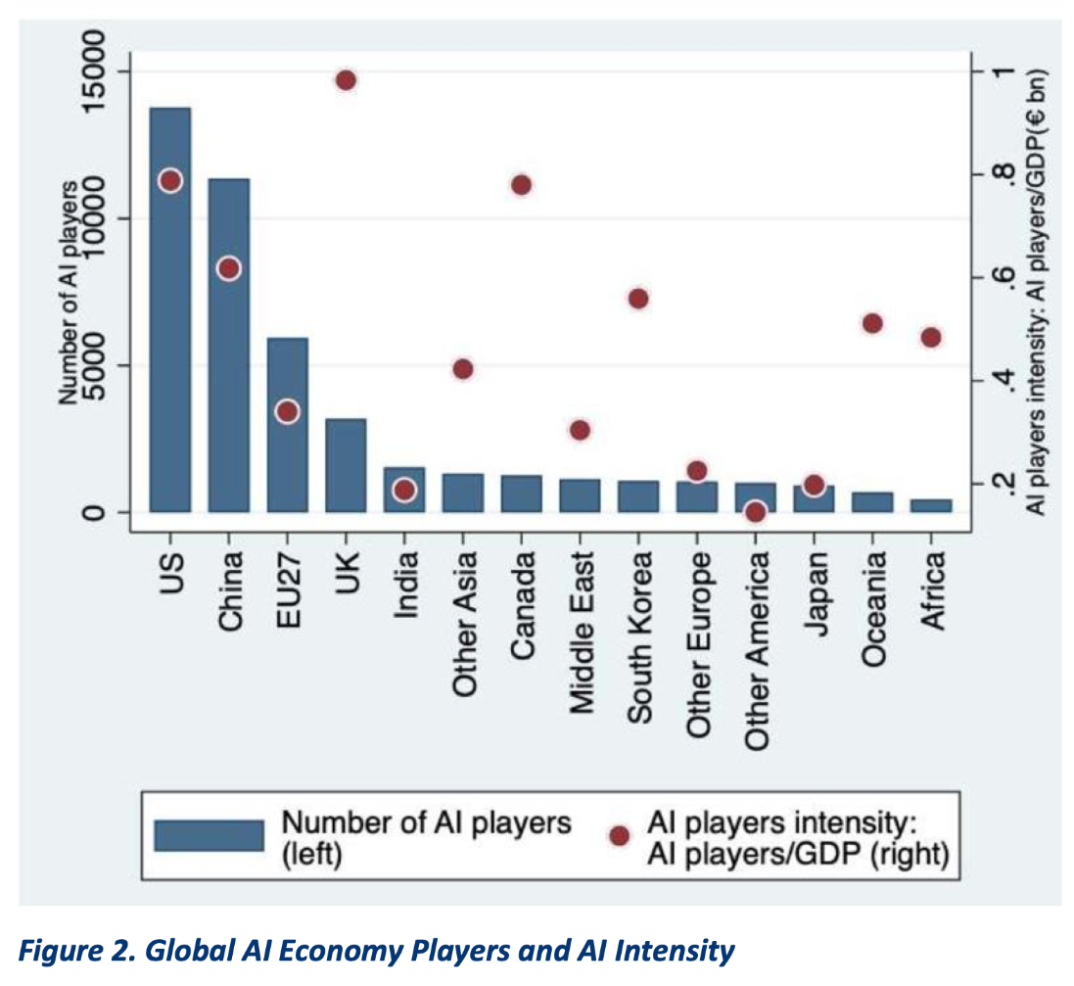
II. THE PRESENT
Where does Africa rank in the global AI race?
11 / 40

Slide 12


II. THE PRESENT
Africa is powering AI. Just not at the point of value-adding.
Critical Minerals
Data
Labour
30% → 10%
$39M → $356M
$1.32–$2/hr
Africa holds 30% of the world’s critical mineral reserves that power AI hardware — but captures only 10% of the revenue they generate.
Africa’s own AI training-data market is projected to grow nearly 10x by 2032 — yet remains a rounding error next to the global AI economy it feeds.
Kenyan workers were paid this to make ChatGPT safer — while OpenAI paid the outsourcing firm up to $12.50/hr per worker for the same task.
ODI Global; Brookings
Credence Research, 2023–2032
Time (2023); CBS 60 Minutes
Africa’s benefit? 2.5% of the global AI market. 0.3% of global AI investment.
Every input comes from Africa — the minerals, the data, the labour. Almost none of the value comes back.
12 / 40

Slide 13
I. THE PATTERN
Five centuries. One script. New commodities.
1500s
1600–1800s
1800s
1900s
2000s
Now
Gold
Enslaved
people
Rubber,
ivory
Copper,
oil
Coltan,
cobalt
Data, attention,
minerals
Each new technological era reaches into the continent for a new raw resource. The destination of the value has not changed.
13 / 40

Slide 14
I. THE PATTERN
Critical Minerals.
14 / 40

Slide 15
I. THE PATTERN
The ratio that runs the continent.
30%
10%
of the world’s critical mineral reserves
sit on the African continent
of the revenue from those minerals
stays in African economies
Source: ODI Global; Brookings — Africa’s strategic positioning in the critical minerals race.
15 / 40

Slide 16

CASE · IN THE NEWS
“Zambia rejects US critical minerals deal over preferential access terms.”
Preferential access for one partner is exactly the clause African negotiators are learning to refuse.
16 / 40

Slide 17

CASE · DATA
Data for infrastructure & aid.
Health data in exchange for aid
The US sought access to national health data from several African states — Zambia among them — as a condition attached to aid.
Data stored offshore — until now
African data has historically been centred outside the continent. In response, a growing number of African states now have policies restricting sensitive and personal data to storage within the continent.
17 / 40

Slide 18
CASE · LABOUR
Cheap labour.
$1.32–$2/hr
Kenyan workers were paid this to label AI training data and moderate content — filtering the worst of the internet to make ChatGPT safer — while the outsourcing firm was paid up to $12.50/hr per worker for the same task.
Source: Time investigation, Jan 2023; CBS 60 Minutes.
18 / 40

Slide 19


CASE · GOVERNANCE
Governance is catching up.
AU Continental AI Strategy
A continent-level strategy adopted by the African Union to coordinate how member states approach AI.
National AI strategies
Individual countries now have AI strategies of their own — a growing patchwork of national approaches.
Data protection laws
Data protection legislation and frameworks are spreading across the continent, setting rules for how data is collected and used.
19 / 40

Slide 20

II. THE PRESENT
The continental ambition.
AU Continental AI Strategy — adopted by the AU Executive Council, 45th Ordinary Session, Accra, July 2024.
Harness AI’s benefits
Build AI capabilities
$1.5T
Minimise risks
Stimulate investment
projected economic value AI could generate for 1.3 billion people
Foster global cooperation
Anchored in AU Agenda 2063.
20 / 40

Slide 21
II. THE PRESENT
Then there is the maths.
Independent estimates of Africa’s AI infrastructure funding gap vs. what African AI startups have actually raised to date ($B).
Even the low estimate is several times what has actually been raised.
Sources: WEF (2025), AfDB green-compute estimate; Carnegie Endowment; StartupList Africa funding tracker (to June 2025).
21 / 40

Slide 22
II. THE PRESENT
And the money that exists goes to four countries.
83% of AI funding on the continent flows to just four countries.
83%
Kenya · Nigeria · South Africa · Egypt
The remaining 17% is spread across the other 51 AU member states.
Source: AU Commissioner for Infrastructure & Energy, Ethio Tech Expo 2025 (Q1 2024 AI startup funding).
22 / 40

Slide 23
II. THE PRESENT
Technology is powering economies.
One AI company’s annualised revenue, next to the GDP of an entire nation ($B).
~1.8x
Anthropic’s revenue now runs at nearly twice Zambia’s entire national GDP.
Sources: World Bank (Zambia GDP, 2024, $26.33B); Bloomberg / VentureBeat / Anthropic disclosures (revenue run-rate, Apr–Jun 2026).
23 / 40

Slide 24

Anthropic made Zambia’s whole GDP in revenue this year.
Vusi Thembekwayo · YouTube Shorts · Published 24 June 2026
Watch the clip: youtube.com/shorts/GsIRzTY3lWc
Anthropic’s revenue run-rate is independently reported at $45–47B (Apr–Jun 2026); Zambia’s GDP is $26.3B (World Bank, 2024). The comparison holds — if anything, it understates the gap.
24 / 40

Slide 25
MENTIMETER
If one company’s revenue can rival a nation’s entire GDP, who actually holds the power at the negotiating table?
25 / 40

Slide 26
II. THE PRESENT
Case in point: the Washington Accords.
Jan–Feb 2025
M23 rebels (widely reported to be Rwanda-backed) occupy Goma, then Bukavu. Millions displaced.
Feb 2025
President Tshisekedi writes to President Trump: minerals access in exchange for security assistance.
27 Jun 2025
Peace agreement signed at foreign-minister level in Washington — the economic / minerals framework is not yet included.
7 Nov – 4 Dec 2025
Regional Economic Integration Framework signed (7 Nov); full Washington Accords signed by heads of state Tshisekedi & Kagame (4 Dec), with Trump presiding.
The pattern: emergency → speed → a mining-cooperation framework agreed well before its enforcement mechanics were tested.
AFRICAN INTELLIGENCE
29 / 40

Slide 27

II. THE PRESENT
Before sovereignty, electricity.
~600M
Electrification has barely kept pace with population growth since 2020 — the absolute gap has stalled, not closed.
sub-Saharan Africans lack access to electricity
“You cannot run a data centre on aspiration alone.”
Source: IEA, Financing Electricity Access in Africa (2024 data).
26 / 40

Slide 28
II. THE PRESENT
The new contract type.
A hyperscaler offers:
In exchange for:
$1–2B data centre
Connectivity rollout
Cloud credits & training
Mining digitisation tech
Data routed & stored offshore
Preferential mineral access
Long operating concessions (15–30 yrs)
Regulatory & tax forbearance
When the state is fiscally squeezed, who actually has the bargaining power?
30 / 40

Slide 29
When the state is fiscally squeezed,
who actually has the bargaining power?
31 / 40

Slide 30
III. THE STAKES
Opportunities for Africa.
32 / 40

Slide 31






III. THE STAKES
Opportunities for Africa.
Digital Public Infrastructure
Education for talent
Home-grown platforms — e.g. Cassava AI — building sovereign digital rails.
Education systems geared to developing AI-ready skills at scale.
Research & development
A conducive SME environment
Investing in African-led AI research and local innovation capacity.
Enabling small businesses — including access to finance at low cost.
Open data
Young talent
Opening public datasets so local builders can create local value.
One of the world’s largest, youngest populations — a demographic edge.
33 / 40

Slide 32
GROUP EXERCISE · OPTION 1
The Cabinet Meeting.
You are the Cabinet. A hyperscaler has offered a $2B data centre — in exchange for offshore data storage, preferential mineral access, and a 20-year concession.
FINANCE MINISTER
ICT MINISTER
MINING MINISTER
“Sign. The budget is squeezed and elections are in 18 months.”
“The data clauses give away too much.”
“Renegotiate the mineral-access clause.”
10 minutes to reach a Cabinet position: sign, renegotiate, or walk away.
If you renegotiate — name exactly what changes. If you walk away — tell the public why the jobs aren’t coming.
34 / 40

Slide 33

II. THE PRESENT
The leverage is in the ground.
AI hardware does not start in Silicon Valley. It starts in a pit.
DRC
Zimbabwe
World’s largest cobalt reserves; major coltan / tantalum source.
Significant lithium deposits — battery-grade demand surging.
56
South Africa
Madagascar & Tanzania
new data centres planned across Africa by 2027
Holds the majority of global platinum reserves.
Rare earth elements for high-tech components.
28 / 40

Slide 34
GROUP EXERCISE · OPTION 2
The $5 Billion Ranking.
You have $5 billion. You can only fund three. Rank them.
National AI Research Centre
Rural Electrification
Data Centres
AI Education
Startup Fund
Fibre Connectivity
Sovereign Cloud
Digital Public Infrastructure
Explain why — and name the one you found hardest to cut.
35 / 40

Slide 35
GROUP EXERCISE · OPTION 3
Three Non-Negotiables.
Your government is signing its first AI partnership. Draft your three non-negotiable clauses — specific enough that a lawyer could use them.
STARTING POINTS
Local data storage
Skills transfer
Local ownership
Technology transfer
Local employment quotas
Environmental protections
Local processing of minerals
Rule: at least one of your three must not come from this list.
36 / 40

Slide 36
GROUP EXERCISE · OPTION 4
The Money.
The AU AI Strategy needs billions; it has raised a fraction of that.
Where should the money come from — and what strings should African states refuse, even from friendly capital?
Be specific: name the sources you’d pursue first, and the conditions that would make you turn funding down.
37 / 40

Slide 37
GROUP EXERCISE · OPTION 5
Headlines from 2035.
You’re writing tomorrow’s history. Draft one newspaper headline from 2035.
“Africa Owns 20% of the Global AI Market”
“Africa Still Supplies Minerals but Imports Intelligence”
“African AI Unicorns Overtake European Startups”
— or write your own.
Then work backwards: what decisions between 2026 and 2035 made your headline possible — and who in this room had to make them?
38 / 40

Slide 38
CLOSING
One word —
what are you leaving with?
Artificial Intelligence. African intelligence
Thank you. Asante. Merci
39 / 40

Slide 39
APPENDIX
References & further reading.
World Bank — Digital transformation drives development in Africa
worldbank.org/en/results/2024/01/18/digital-transformation-drives-development-in-afe-afw-africa
African Union — Data Policy Framework (2024)
au.int/sites/default/files/documents/42078-doc-DATA-POLICY-FRAMEWORKS-2024-ENG-V2.pdf
African Union, AI Strategy
https://au.int/en/documents/20240809/continental-artificial-intelligence-strategy
https://www.tortoisemedia.com/data/global-ai
40 / 40

Slide 40
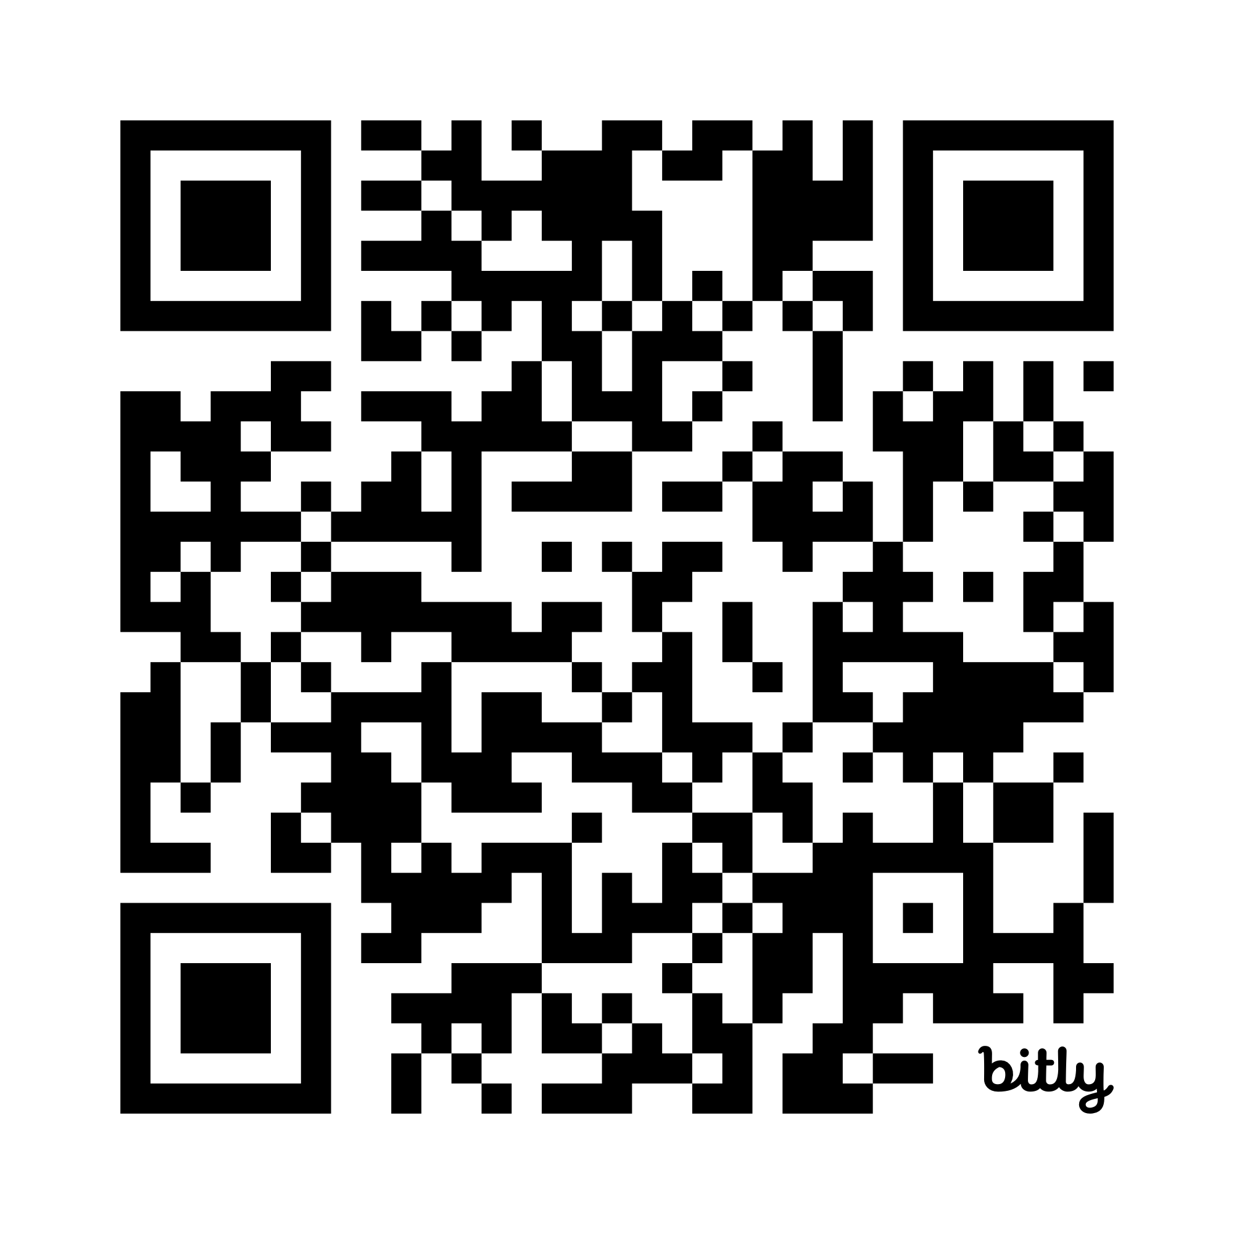
Let’s Connect!
40 / 40

