Slide 1
v
Tax Governance and Critical Minerals in Africa
Taxation and the Resource Curse
Ishmael Zulu – Senior Policy Officer Tax and Equity

Slide 2
SUMMARY
INTRODUCTION
Debt Mineral Paradox
Critical Minerals
IFFs
UNTC
Conclusion
1
Understand the link between debt, taxation and resource governance.
Explain the strategic importance of critical minerals.
Identify major tax governance challenges in the mining sector.
Examine the political economy of illicit financial flows.
Understand the opportunities presented by the UN Framework Convention on International Tax Cooperation.
Explore pathways for turning mineral wealth into sovereign wealth.
2
3
4
5

Slide 3
Africa's Debt Challenge
Why does Africa remain indebted despite being home to the minerals powering the global energy transition, and what tax governance reforms are needed to convert mineral wealth into sovereign wealth?

Slide 4
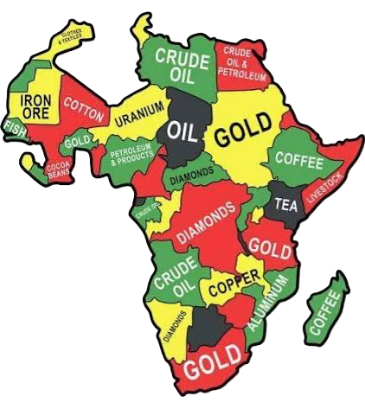
4
01
Setting the Context
Africa possesses:
30% of the world's mineral reserves.
Significant deposits of copper, cobalt, lithium, nickel, graphite and manganese.
Many of the minerals required for batteries, electric vehicles, renewable energy systems and digital technologies.
Yet many resource-rich countries continue to face:
Rising debt burdens.
Fiscal deficits.
Poverty and inequality.
Limited industrialisation.
This contradiction sits at the centre of today's discussion.

Slide 5
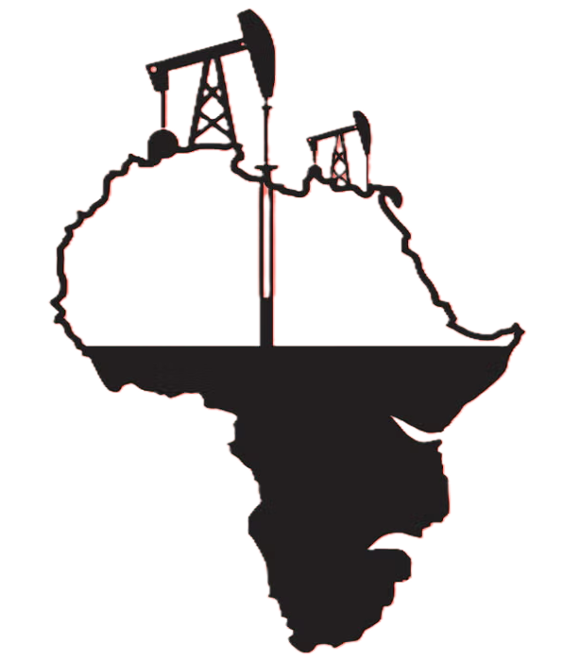
5
02
The Debt-Minerals Paradox
Why do countries rich in natural resources continue to borrow for development?
Examples across Africa show:
Resource wealth does not automatically translate into prosperity.
Export earnings do not necessarily result in public revenue.
Economic growth does not always reduce inequality.
The issue is often not resource abundance.
The issue is value capture.

Slide 6

6
03
Zambia: A Reality Check
Zambia provides a useful case study.
Mining contributes over 70% of exports.
Mining contributes approximately 30% of government revenues.
Mining remains one of the largest sectors in the economy.
Yet Zambia experienced:
Growing public debt.
Poverty.
Fiscal distress leading to debt restructuring.
The lesson is clear:
Resource extraction alone does not guarantee development.

Slide 7
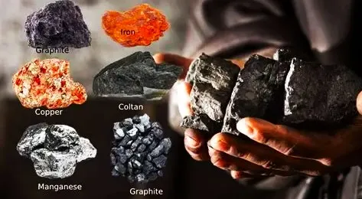
7
04
Understanding Critical Minerals
Critical minerals are minerals essential for:
Clean energy technologies.
Electric vehicles.
Battery storage systems.
Solar and wind technologies.
Artificial intelligence infrastructure.
Data centres and digital transformation.
Examples include:
Copper
Cobalt
Lithium
Nickel
Graphite
Manganese
These minerals are becoming the "oil" of the green economy

Slide 8
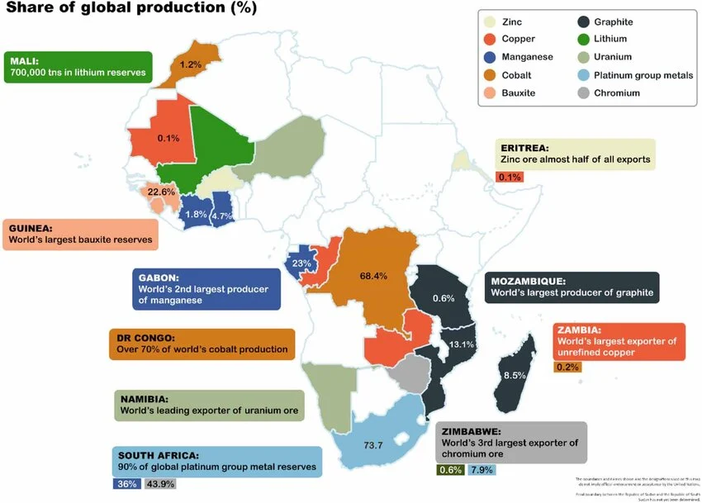
Source: https://www.researchgate.net/figure/Africas-main-reserves-and-production-of-key-green-transition-minerals-Source-African_fig4_380311110
Notes:
Source- https://www.researchgate.net/figure/Africas-main-reserves-and-production-of-key-green-transition-minerals-Source-African_fig4_380311110

Slide 9

9
05
The Energy Transition
The global economy is moving from:
Fossil Fuel Economy
Oil • Coal • Gas
To
Low Carbon Economy
Renewables • Batteries • Electrification • Energy Storage
This transition is increasing demand for critical minerals worldwide.
According to research, demand for many energy-transition minerals is expected to grow substantially as governments pursue decarbonisation goals.

Slide 10
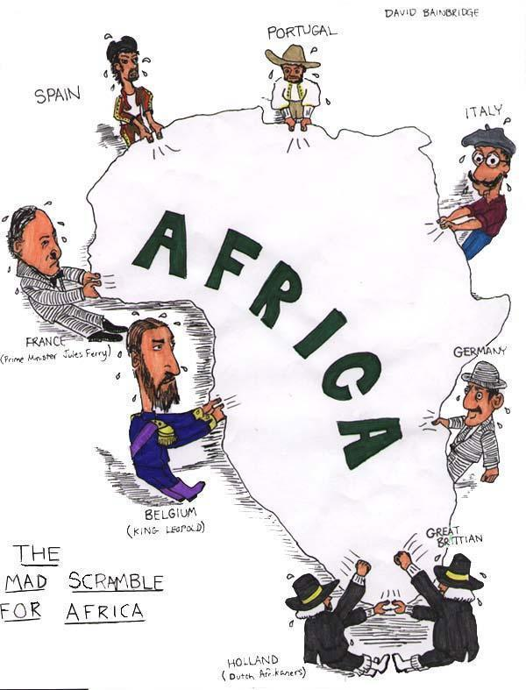
10
06
Colonial Patterns, Modern Forms
Historically:
Africa exported raw materials.
Today:
Many countries still export unprocessed minerals.
As a result:
Value is captured elsewhere.
Jobs are created elsewhere.
Manufacturing is concentrated elsewhere.
Tax revenues often leak elsewhere.
The challenge is therefore not merely extraction.
The challenge is structural transformation.

Slide 11
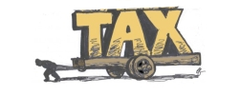
11
07
Why Tax Governance Matters
Tax governance determines:
Who benefits from mineral wealth.
How much revenue governments collect.
Whether communities see development outcomes.
Whether countries can finance public services.
Whether debt dependence continues.
Weak tax systems mean resource-rich countries remain revenue-poor.

Slide 12
The Triple Crisis
Africa is currently confronted with a triple crisis
1. Tax Abuse
Revenue loses through avoidance and evasion (IFFs)
2. Resource Extraction
Limited value retention from natural resources
3. Climate Crisis
A continent that contributed least to emissions suffers disproportionately from climate impacts.
These crises reinforce one another.

Slide 13
Annual losses on account of IFFs are currently estimated at US$ 88.6 billion a conservative figure, given that some forms of IFFs cannot be properly computed such as drug and/or human trafficking
IMPACT OF IFFs IN AFRICA
The current tax systems are vulnerable, facing revenue limitations to tackle current crises. They are unable to meet the annual gap of $1.2 trillion needed for social protection in developing countries
Africa is one of the most affected by IFFs. Multinational corporations exploit weak regulatory frameworks in African countries, undermining tax justice and sustainable development.
Moreover, developing countries often lack the resources and capacity to effectively monitor and regulate the activities of multinational corporations and wealthy individuals

Slide 14

14
10
COMMERCIAL IFFs
These arise from business-related activities deliberately planned with a goal to, among others, hide wealth, evade or aggressively avoid tax, and dodging customs duties and domestic levies
Why they matter:
Largest share of IFFs in Africa (≈ majority from commercial sources)
Key actors:
Multinational corporations (MNCs)
High-net-worth individuals
Financial intermediaries (lawyers, accountants)
Notes:
Explain that commercial IFFs are the largest share of African IFFs, dwarfing criminal and corruption flows.
These are business-related and deliberate: hiding wealth, evading or aggressively avoiding tax, dodging customs duties.
Identify the main actors — multinational corporations, high-net-worth individuals, and enabling intermediaries (lawyers, accountants, bankers).
Underline the systemic angle: this is not isolated bad apples but a structured ecosystem.
Bridge to the next slides where you unpack specific techniques used.

Slide 15
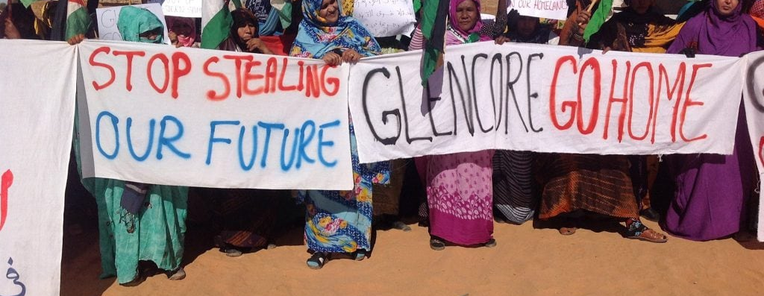
2022 Glencore Scandal
Glencore faced multiple legal actions for bribery, tax evasion, and trade mis-invoicing, exposing how multinationals exploit African resources while avoiding fair taxation.
Paying off government officials to secure preferential access to oil and mineral deals across Nigeria, Cameroon, Ivory Coast, Equatorial Guinea, and South Sudan.
Moved profits from high-tax African jurisdictions to low-tax subsidiaries abroad
Underreporting the value of exports and inflating operating costs
Routing profits through shell companies in Bermuda, the British Virgin Islands, and Switzerland
Utilising complex corporate structures and nominee shareholders to conceal true ownership
This case summarises how multinationals exploit African resources
Notes:
Use the 2022 Glencore case as the anchor example for the rest of the deck.
Highlight the multiple offences: bribery, tax evasion, and trade mis-invoicing across several African countries.
Name the affected countries — Nigeria, Cameroon, Ivory Coast, Equatorial Guinea, South Sudan.
Describe how profits were shifted from high-tax African jurisdictions to low-tax subsidiaries.
Mention the use of shell companies in Bermuda, the British Virgin Islands, and Switzerland, with nominee shareholders concealing ownership.
Frame Glencore as illustrative of broader patterns, not an outlier.

Slide 16

Trade mispricing is the practice of manipulating the prices declared on cross-border transactions between related parties to shift profits from high-tax to low-tax jurisdictions. It typically involves multinationals setting artificial transfer prices between subsidiaries to reduce overall tax liability and erode the tax base of source countries.
TRADE
MISPRICING
Glencore engaged in trade mispricing by selling commodities from its African subsidiaries to related entities in low-tax jurisdictions at below-market prices, shifting profits offshore and reducing taxable income in source countries.
Notes:
Define trade mispricing: manipulating prices on cross-border transactions between related parties.
Contrast with mis-invoicing — mispricing is intra-group, while mis-invoicing typically distorts customs declarations.
Explain how multinationals set artificial transfer prices between subsidiaries to shift profits to low-tax jurisdictions.
Use Glencore as the example: selling African commodities to related entities at below-market prices.
Stress the impact on source-country tax bases and the difficulty of detection without comparable market data.

Slide 17
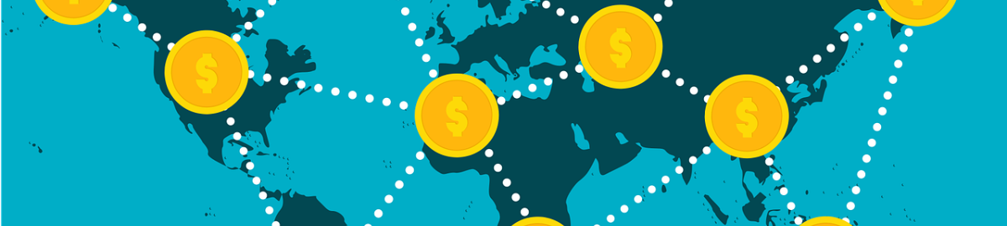
TRANSFER PRICING
The company used abusive transfer pricing strategies to shift profits from Africa to low-tax subsidiaries abroad
EXAMPLE
Transfer pricing is the price set for transactions between related businesses or entities. It's used to price the sale or purchase of goods and services and the use of intangibles.
Copper and cobalt mined in the DRC were sold to Glencore’s Swiss subsidiaries at prices below market value, reducing taxable profits in the DRC.
Notes:
Define transfer pricing as the price set for transactions between related entities for goods, services, or intangibles.
Note that transfer pricing itself is legitimate — it is abuse of it that creates IFFs.
Use the DRC copper and cobalt example: Glencore sold to its Swiss subsidiaries at prices below market value.
Explain how this reduces taxable profits in the source country (DRC) while inflating them in the low-tax destination.
Mention the OECD arm's-length principle as the international benchmark for fair pricing.

Slide 18

Aggressive tax planning is the use of complex legal structures and loopholes in tax laws to minimise tax liability in ways that conflict with the spirit, if not the letter, of the law. It typically involves routing profits through low-tax jurisdictions, hybrid mismatches, and intra-group financing arrangements to reduce a multinational's effective tax rate.
AGGRESSIVE TAX
PLANNING
Glencore engaged in aggressive tax planning by channelling earnings through subsidiaries in jurisdictions such as Switzerland, Bermuda, and the Netherlands, using intra-group loans and holding structures to substantially lower its global effective tax rate.
Notes:
Define aggressive tax planning: using complex legal structures and loopholes to minimise tax in ways that conflict with the spirit of the law.
Typical features: routing profits through low-tax jurisdictions, hybrid mismatches, and intra-group financing.
Use Glencore's example — channelling earnings through Switzerland, Bermuda, and the Netherlands.
Explain hybrid mismatches simply: an instrument treated as debt in one country and equity in another to gain a tax advantage.
Emphasise that aggressive planning is often legal yet still erodes public revenue.

Slide 19
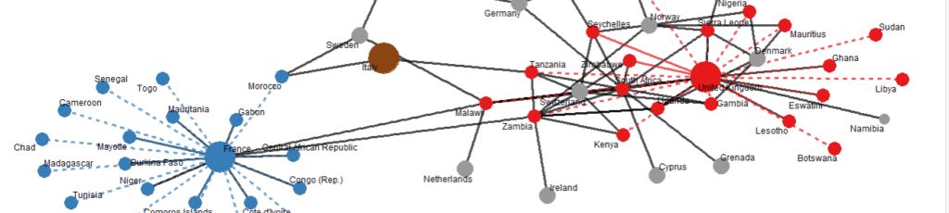
Tax treaty shopping is the practice of routing investments or income through an intermediary jurisdiction solely to access the benefits of a favourable double-taxation treaty. It typically involves multinationals setting up conduit or holding companies in treaty-rich jurisdictions to reduce withholding taxes on dividends, interest, and royalties paid out of source countries.
TAX TREATY
SHOPPING
Glencore engaged in tax treaty shopping by routing investments into African operations through Dutch and Mauritian holding companies, taking advantage of favourable treaty networks to minimise withholding taxes on dividends and interest flowing out of source countries.
Notes:
Define treaty shopping: routing investment through an intermediary country solely to access favourable tax treaty benefits.
Common goal: reduce withholding taxes on dividends, interest, and royalties leaving source countries.
Use the Glencore case: routing African investments through Dutch and Mauritian holding companies.
Note that many African countries have signed treaties that disproportionately favour capital-exporting countries.
Mention current reform efforts — renegotiating treaties and including anti-abuse clauses.

Slide 20

Thin capitalisation is the practice of funding a subsidiary with a disproportionately high level of debt relative to equity, so that taxable profits in the source country are stripped out through deductible interest payments. It typically involves multinationals routing intercompany loans from low-tax jurisdictions to reduce the taxable base of operating companies in higher-tax countries.
THIN
CAPITALISATION
Glencore engaged in thin capitalisation by funding its African operating subsidiaries with substantial intercompany loans from related entities in lower-tax jurisdictions, generating large deductible interest expenses that eroded the taxable profits reported in source countries.
Notes:
Define thin capitalisation: funding a subsidiary with disproportionately high debt relative to equity.
The mechanism: interest payments are deductible, so heavy intercompany debt strips taxable profits out of the source country.
Glencore example: large intercompany loans from related entities in lower-tax jurisdictions to African subsidiaries.
Mention common policy responses — debt-to-equity ratios and interest deduction limits (e.g., 30% of EBITDA).
Tie back to the broader pattern of intra-group financing as a profit-shifting tool.

Slide 21
21
12
What is the Global Tax Architecture?
The global tax architecture refers to the institutions, rules, norms, and agreements that govern how countries tax cross-border economic activities.
It determines:
  Who gets to tax multinational companies
  How taxing rights are shared between countries
  What global rules exist to prevent tax avoidance
Unfair international tax rules and widespread tax avoidance reduce governments’ ability to invest in services that support vulnerable groups, including women and low-income communities.
Multinational Enterprises should pay their fair share of taxes

Slide 22
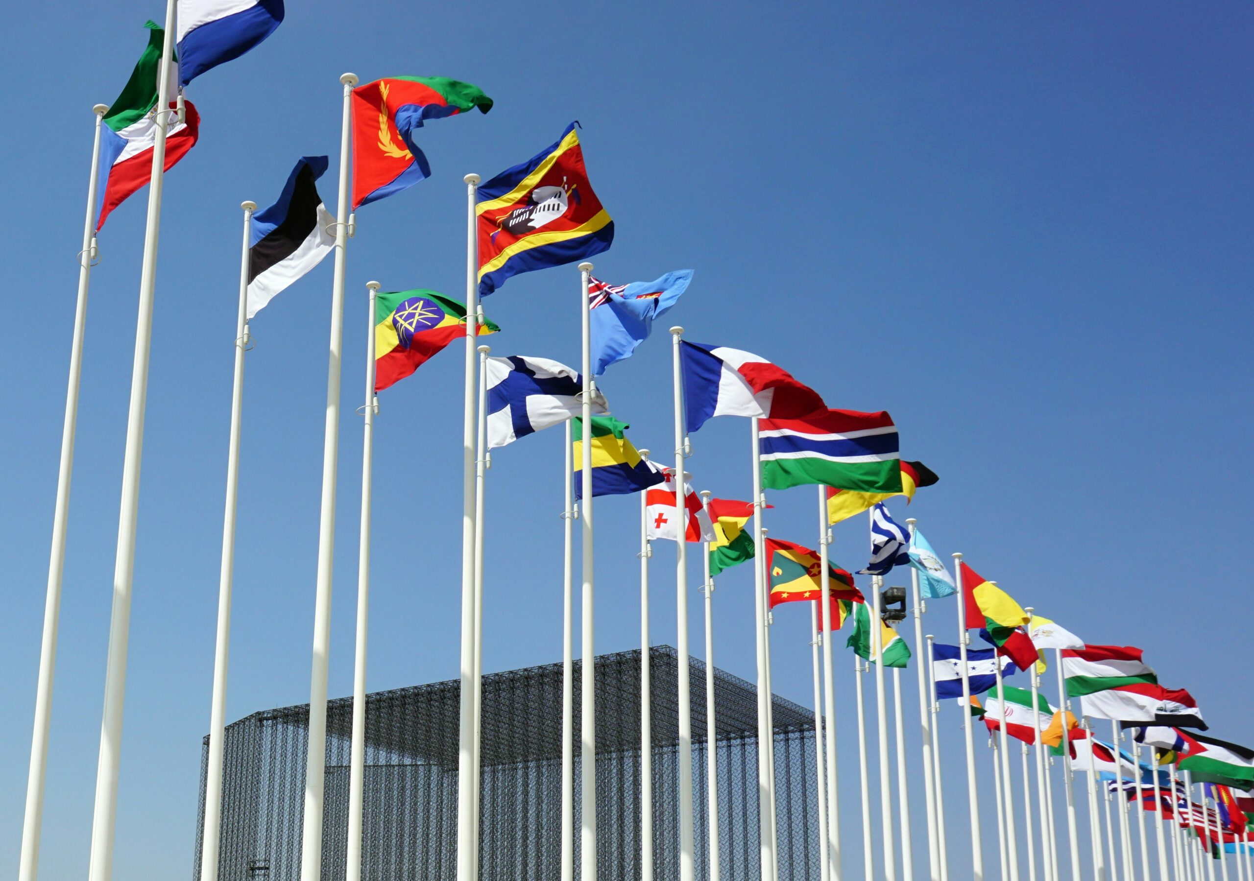
22
13
The Global Tax Governance Problem
For decades, international tax rules were largely shaped outside the United Nations.
Many developing countries had limited influence over:
Allocation of taxing rights.
International tax standards.
Corporate taxation reforms.
This contributed to an imbalance in global tax governance.

Slide 23
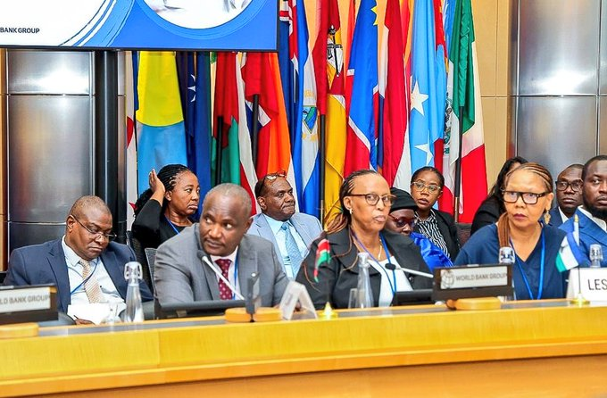
23
14
Africa’s Leadership at the UN
In 2023, the Africa Group successfully advanced negotiations toward a UN Framework Convention on International Tax Cooperation.
This represents a historic shift.
For the first time, there is a pathway toward more inclusive and universal tax rule-making under the United Nations.

Slide 24

24
15
Why the UN Tax Convention Matters
The emerging framework seeks to promote:
Fair tax systems.
Transparency.
Combatting illicit financial flows.
Equitable allocation of taxing rights.
International cooperation.
Its objective is to help countries mobilise resources for sustainable development.

Slide 25
Key Elements of Reform
Public Country-by-Country Reporting
Knowing where profits are made and where tax is paid.
Automatic Exchange of Information
Improving international cooperation
Beneficial Ownership Transparency
Knowing who really owns companies.
Effective Taxation of Extractives
Addressing vulnerabilities in the mining sector.

Slide 26
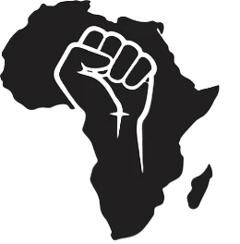
26
17
Africa’s Policy Priorities
To maximise benefits from critical minerals, African countries should:
Strengthen tax administration.
Improve monitoring systems.
Address transfer pricing risks.
Review harmful tax incentives.
Renegotiate unfavourable tax treaties.
Enhance transparency.
Invest in value addition and beneficiation.

Slide 27
27
18
From Extraction to Sovereign Wealth
Critical minerals should finance:
Education.
Healthcare.
Infrastructure.
Climate adaptation.
Industrialisation.
Future generations.
The objective is to transform finite natural resources into lasting public wealth.
This requires strong institutions, transparency and accountability.

Slide 28

28
19
Key Takeaways
Africa is rich in resources but often poor in value capture.
Critical minerals present a historic opportunity.
Illicit financial flows undermine development financing.
Tax governance is central to fiscal sovereignty.
The UN Tax Convention provides a unique opportunity for Africa to influence global tax governance.

Slide 29
^{@Taxjusticenetworkafrica}

