Slide 1

The shifting Global Economic Order, implications on Trade and debt in Africa: Proposals on the Way Forward
JANE and Hilda

Slide 2
Objectives of this session
The overall objective;
To deepen participants’ understanding & appreciation of Africa’s position in the evolving global economic order, its trade dynamics, debt challenges, and the policy options for sustainable structural transformation.

Slide 3
Question
Provide practical proposals on how Africa can trade it’s way out of the growing debt crisis

Slide 4
Outline
Introduction
Africa’s position in the global economy
Historical roots of Africa’s trade structure
The new Economic order
Systemic Trade imbalance, public debt and false solutions
Way forward

Slide 5
Introduction
The link between trade and debt
The SDG Agenda 2030 & Agenda 2063 recognizes international trade as a mechanism through which some of these goals can be achieved;
Trade is a source of foreign exchange, facilitates exchange of goods and services
Enjoying proceeds of trade requires Countries’ deliberate interventions to invest in ventures that facilitate smooth running of the economy
Due to continuous revenue shortages, African Countries opt to borrow to finance such investments.

Slide 6

Africa’s Position in the Global Economy
Resource-rich, value-poor
  Home to vast reserves of critical minerals, energy resources, and arable land.
  More than half of African Countries rely on oil, gas and other minerals. These account for at least 60 percent of their export earnings
  A marginal player in global trade
  Accounts for nearly 19% of the global population but only about 3% of global merchandise trade.
  Limited participation in global and regional value chains.
  Low Regional Integration
  Intra-African trade accounts for only 15–18% of total African trade.
  Weak industrial linkages and high trade costs constrain regional commerce.
  Persistent structural trade imbalance
  Exports mainly raw materials while importing higher-value manufactured goods.
  Limited industrialization and export diversification contribute to trade deficits.
  Growing external debt vulnerability (domestic debt)
  Low export earnings exposes Africa to forex risks.
Notes:
---
This slide references information from the following file: https://seatiniuganda-my.sharepoint.com/personal/htumuhe_seatiniuganda_org/_layouts/15/Doc.aspx?sourcedoc=%7B965F62EF-1C51-4BC1-B6CE-5E2D747F157D%7D&file=Revised%20%2BM.O%20-%20Trade%20Not%20Aid%20Shift.docx&action=default&mobileredirect=true
Africa occupies a marginal position in the global economy despite its vast resource endowments and demographic potential. The continent accounts for roughly 3 percent of global GDP, about 2.5 percent of global merchandise exports, and only around 2 percent of global manufacturing value added. Manufactured exports constitute just a small fraction of Africa’s trade, while primary commodities dominate export profiles. Fuels, ores, and unprocessed agricultural goods make up more than three-quarters of merchandise exports, leaving African economies highly exposed to price volatility and external demand shocks. Intra-African trade remains low, hovering around 16 percent, reflecting weak regional value chains and limited industrial integration. Moreover, Africa imports nearly three times the value of manufactured and medium-to-high-technology goods that it exports, reinforcing persistent trade deficits. These patterns are not accidental but the result of a global trade architecture designed to favor value addition in industrialized economies. Any serious discussion of trade-led development must begin with this structural reality, recognizing that without deliberate transformation, increased trade alone will not alter Africa’s subordinate position.

Slide 7
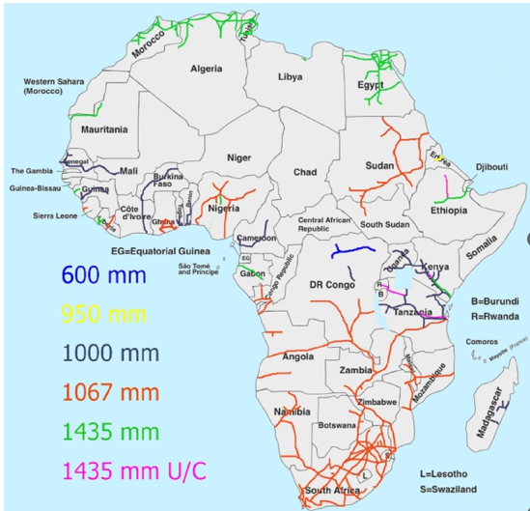
Historical Roots of Africa’s Trade Structure and position
Major infrastructure in post-colonial Africa.
Colonial Extraction Legacy
  Centuries of colonial extraction shaped Africa’s trade – Balkanization
  resource exploitation and labor through slave trade.
  imposition of monoculture exports, limiting economic diversification
Post-Colonial Trade Continuity
  Extractivist infrastructural policy – undermining intra trade
  All major infrastructure connect Africa to the coast
  evolving initiatives like Every thing But Arms (EBA) , Stabilization of exports, tariff escalation
  Structural constraints – SAPs, bilateral and multilateral trade agreements
Notes:
---
This slide references information from the following file: https://seatiniuganda-my.sharepoint.com/personal/htumuhe_seatiniuganda_org/_layouts/15/Doc.aspx?sourcedoc=%7B965F62EF-1C51-4BC1-B6CE-5E2D747F157D%7D&file=Revised%20%2BM.O%20-%20Trade%20Not%20Aid%20Shift.docx&action=default&mobileredirect=true
Africa’s contemporary trade position is deeply rooted in centuries of colonial extraction and structural manipulation. European industrialization was financed in part by the transatlantic slave trade and the systematic exploitation of African labor and resources. Colonial administrations deliberately dismantled indigenous manufacturing, imposed monoculture export systems, and built infrastructure oriented toward extraction rather than regional integration. These policies entrenched Africa’s role as a primary commodity exporter and prevented the development of diversified economies. Independence did not dismantle these structures; instead, post-colonial trade relations largely preserved colonial patterns under new institutional arrangements. Recognizing these historical roots is essential, as they underscore that Africa’s marginalization is not the result of policy failure alone but of a global system designed to extract value over time. Any new trade framework that ignores this legacy risks perpetuating historical injustices under the guise of modernization.

Slide 8
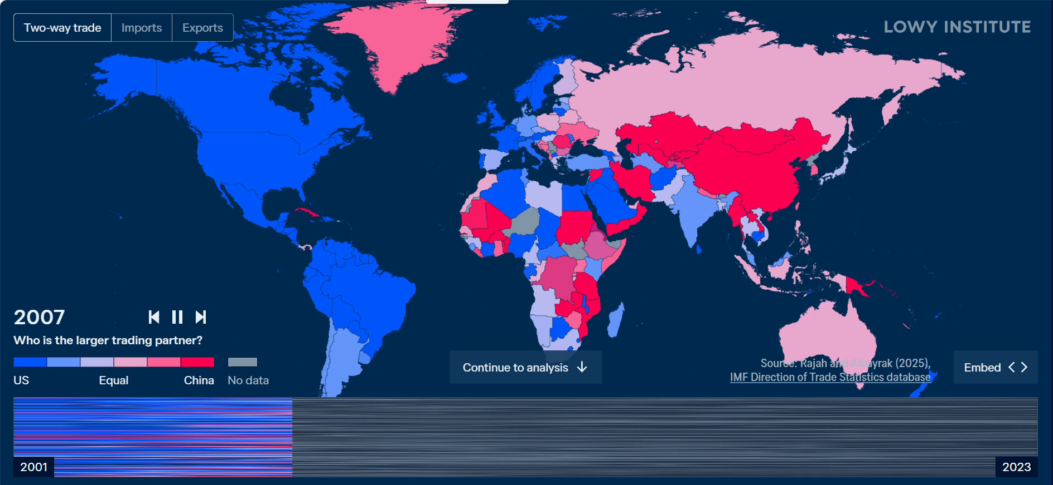
The new economic order
Declining multilateralism China VS USA scramble for Africa’s resources
  Unilateral measures – EUDR, Trump tariffs
  Weaking of WTO, collapse of the latest Ministerial Conference
  EU – modernized EPAs
  USA – health systems in Africa
Notes:
---
This slide references information from the following file: https://seatiniuganda-my.sharepoint.com/personal/htumuhe_seatiniuganda_org/_layouts/15/Doc.aspx?sourcedoc=%7B965F62EF-1C51-4BC1-B6CE-5E2D747F157D%7D&file=Revised%20%2BM.O%20-%20Trade%20Not%20Aid%20Shift.docx&action=default&mobileredirect=true
The ‘trade not aid’ narrative is presented as a progressive evolution in development thinking, suggesting a move away from dependency on aid toward mutually beneficial commercial partnerships. Proponents argue that trade and private investment are more sustainable drivers of growth than concessional finance, fostering entrepreneurship, job creation, and integration into global markets. In official discourse from the United States, European Union, and United Kingdom, Africa is increasingly described as a market of the future rather than a recipient of charity. However, this narrative obscures critical realities. First, it is not new; similar arguments have been used for decades to justify liberalization and reduced aid without dismantling structural barriers to industrialization. Second, it often shifts conditionality rather than removing it, transferring policy constraints from aid frameworks to trade agreements, investment rules, and regulatory regimes. Third, it assumes a level playing field that does not exist, ignoring historical injustices and current asymmetries in bargaining power. As articulated in the source document, the doctrine repackages commercial self-interest—particularly access to resources and strategic supply chains—as partnership. Without deliberate corrective measures, ‘trade not aid’ risks deepening Africa’s marginalization by locking countries into low-value roles within global markets while denying them the policy space required for structural transformation.

Slide 9
Systemic Trade imbalance, public debt and false solutions
Why the systemic imbalance?
Multiple recurrent shocks
COVID 19, Russia Ukraine war, US Iran war
Trade disruptions –
low exports
decline in commodity prices.
Balance of payment crisis- trade deficit
e.g. the decline in copper prices contributed to Zambia’s debt crisis in 2020 – mining contributed over 72% of total export earnings and 44% of government revenues in 2022
Debt Sustainability Framework – LIC DSF
False solutions
Structural Adjustment Programs
  SAPs promoted trade liberalization and privatization
  Blended finance
  De risking private capital
  Innovative financing
  Debt for nature swaps
  Green financing – more debt creating
  Debt Burden and Capital Flight
  Debt burdens intensified with high borrowing costs
  liberalization of the current account facilitated capital flight and illicit financial flows.
  Fiscal Consolidation
  Increasing debt
  low DRM
  large nugatory expenditure
Notes:
---
This slide references information from the following file: https://seatiniuganda-my.sharepoint.com/personal/htumuhe_seatiniuganda_org/_layouts/15/Doc.aspx?sourcedoc=%7B965F62EF-1C51-4BC1-B6CE-5E2D747F157D%7D&file=Revised%20%2BM.O%20-%20Trade%20Not%20Aid%20Shift.docx&action=default&mobileredirect=true
Following independence, many African countries faced severe fiscal and balance-of-payments crises, leading to increased reliance on external borrowing and international financial institutions. Structural Adjustment Programs implemented in the 1980s and 1990s promoted trade liberalization, privatization, and reduced public spending, ostensibly to restore macroeconomic stability. While some institutions claimed success, extensive evidence shows these programs had limited impact on growth and often weakened state capacity. Liberalization facilitated capital flight, illicit financial flows, and the underpricing of African labor and commodities through unequal exchange. Debt burdens have since intensified, exacerbated by high borrowing costs from private and bilateral creditors. These post-colonial dynamics constrain Africa’s ability to leverage trade for development, as fiscal pressures and policy conditionalities limit investment in industrialization and social infrastructure.

Slide 10
Way forward
  Promote Promote Industrialization and Economic Diversification towards structural transformation
  Invest in manufacturing, agro-processing, and critical mineral beneficiation.
  Strengthen productive capacities to increase competitiveness and participation in global value chains
  Reclaiming Policy Space
  Advocate for reforms to the global financial architecture that provide greater fiscal flexibility for development.
  Align fiscal, industrial, and trade policies to support long-term structural transformation rather than short-term stabilization.
  Accelerate Regional Integration and Value Addition
  Fully implement the African Continental Free Trade Area (AfCFTA) to deepen intra-African trade.
  Develop regional value chains and promote value addition to reduce dependence on raw commodity exports.
  Harness Technology and Innovation
  Negotiate trade and investment agreements that facilitate technology transfer, skills development, and digital transformation.
  Build innovation ecosystems to enhance productivity and industrial competitiveness.
  Strengthen Debt Sustainability and Development Finance
  Feasible debt restructuring solutions.
  Strengthen Africa's Voice in Global Economic Governance
  Promote coordinated African positions in global trade and financial negotiations.
  Advance reforms to international trade and financial institutions to better reflect Africa's development priorities.
  Principles of Reparative Justice
  Trade frameworks must address historical extraction and structural imbalances to ensure true development..
Notes:
---
This slide references information from the following file: https://seatiniuganda-my.sharepoint.com/personal/htumuhe_seatiniuganda_org/_layouts/15/Doc.aspx?sourcedoc=%7B965F62EF-1C51-4BC1-B6CE-5E2D747F157D%7D&file=Revised%20%2BM.O%20-%20Trade%20Not%20Aid%20Shift.docx&action=default&mobileredirect=true
A sustainable path forward requires reclaiming policy space and restructuring Africa’s role in global trade. This includes the right to deploy industrial policy tools such as tariffs, subsidies, export restrictions, and strategic procurement to promote domestic value addition. Strengthening the African Continental Free Trade Area is critical for building regional value chains, expanding intra-African trade, and reducing dependence on external markets. Trade and investment agreements must embed technology transfer obligations and protect regulatory autonomy. Above all, trade frameworks should be grounded in principles of reparative justice, recognizing historical extraction and correcting structural imbalances. Without these measures, ‘trade not aid’ will remain a rhetorical shift rather than a transformative development strategy for Africa.

Slide 11
THANK YOU

